Slide 1
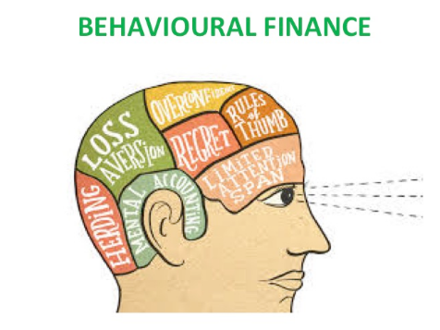
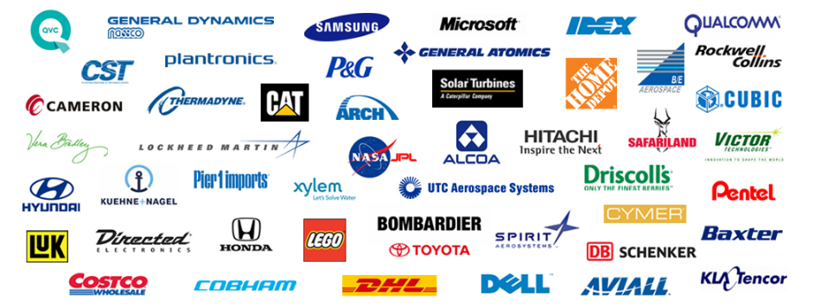
Psychology of Investing & How Great businesses prosper ?
- Krishna Kishore A

Slide 2
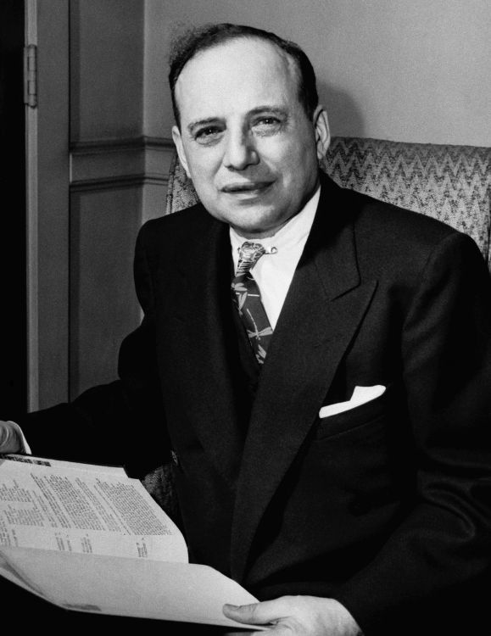
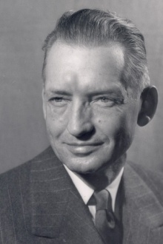
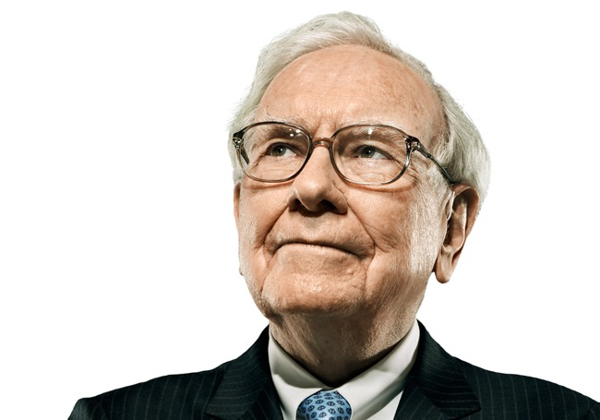
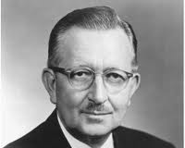
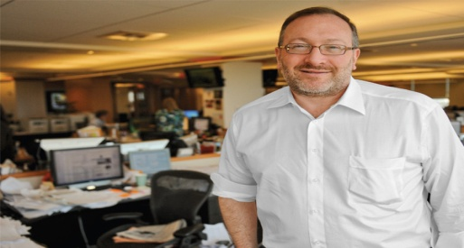
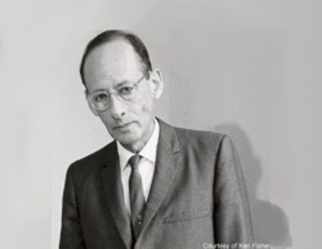
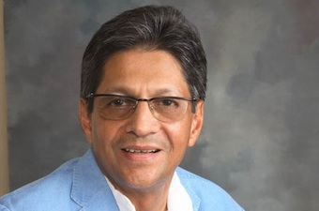

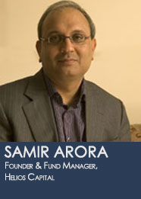
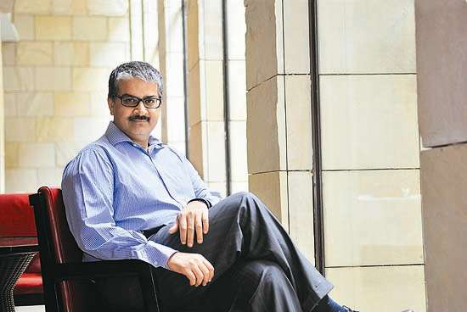
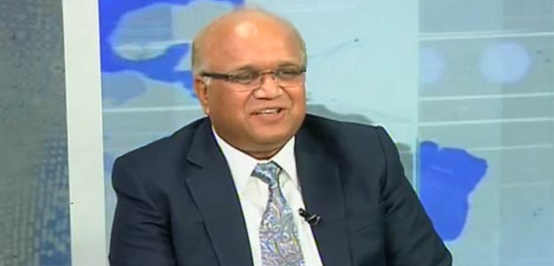
The ambiguity of a Value Growth Investor
What approach should I follow ?
Value Investing or
Growth Investing ??

Slide 3
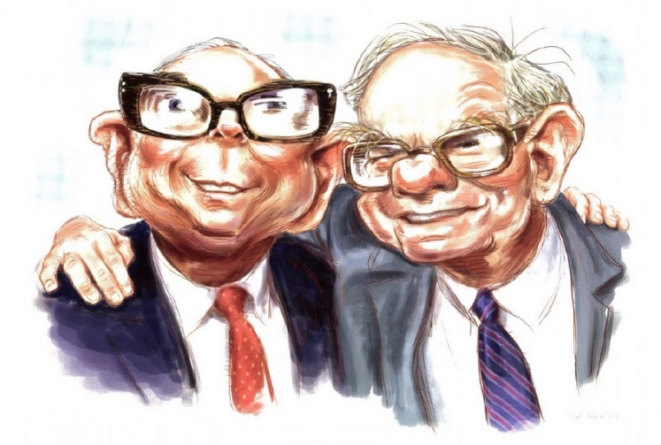
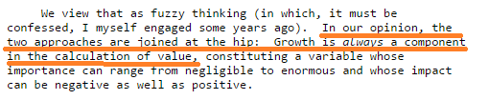
- Warren Buffett, 1992 Berkshire Hathaway letter to shareholders.

Slide 4
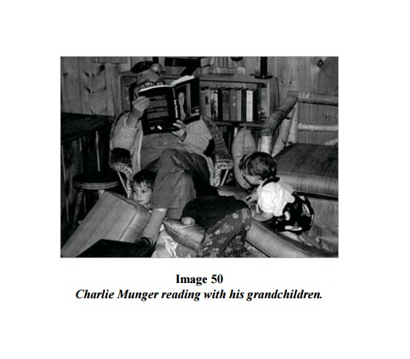
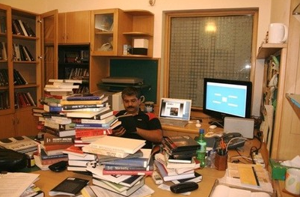
Be a voracious reader !!!
“In my whole life, I have known no wise people (over a broad subject matter area) who didn’t read all the time — none. Zero. You’d be amazed at how much Warren reads — and how much I read. My children laugh at me. They think I’m a book with a couple of legs sticking out.” – Charlie Munger
“ I am a book-loving maniac who reads books in the driver's seat of his car at traffic crossings while waiting for the light to turn green. Why waste a moment ?” – Sanjay Bakshi
“The first time I decided to make it BIG in Equities, I started reading all investment books about people who made it in stock markets. I read around 200 books in next couple of years” – Basant Maheswari

Slide 5
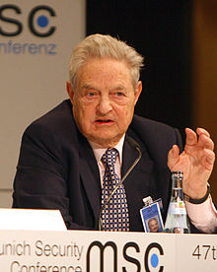
What to Buy ?
Look at businesses where you can see the future for at least ten years. Now look at companies within the industry which have management caliber, competitive advantage and potential to grow at above industry rate. This can be done very simply by keeping your eyes and ears open.
Know your Circle of competency.
“You don’t have to be an expert on every company, or even many. You only have to be able to evaluate companies within your circle of competence. The size of that circle is not very important. Knowing its boundaries, however, is vital.” – Warren Buffett
Really smart people fall prey to this problem, one of the greatest money managers of the world, George Soros, couldn't bear to see others make money in the technology sector without him, and he got hurt.

Slide 6
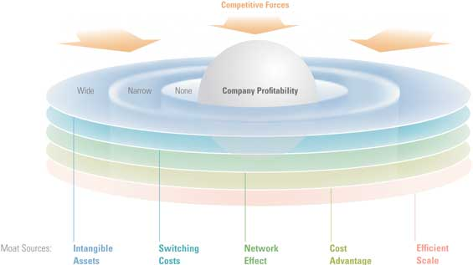




Look for business with Economic Moat !!!
Economic moats can protect companies from competition, helping them earn more money for a long time, and therefore making them more valuable to an investor.
Intensity of competition amongst existing players in the industry.
Threat of new entrants.
Threat of Substitute Products or Services.
Bargaining Power of Customers.
Bargaining Power of Suppliers.
Switching costs.
Distribution network.
Low cost advantage.

Slide 7
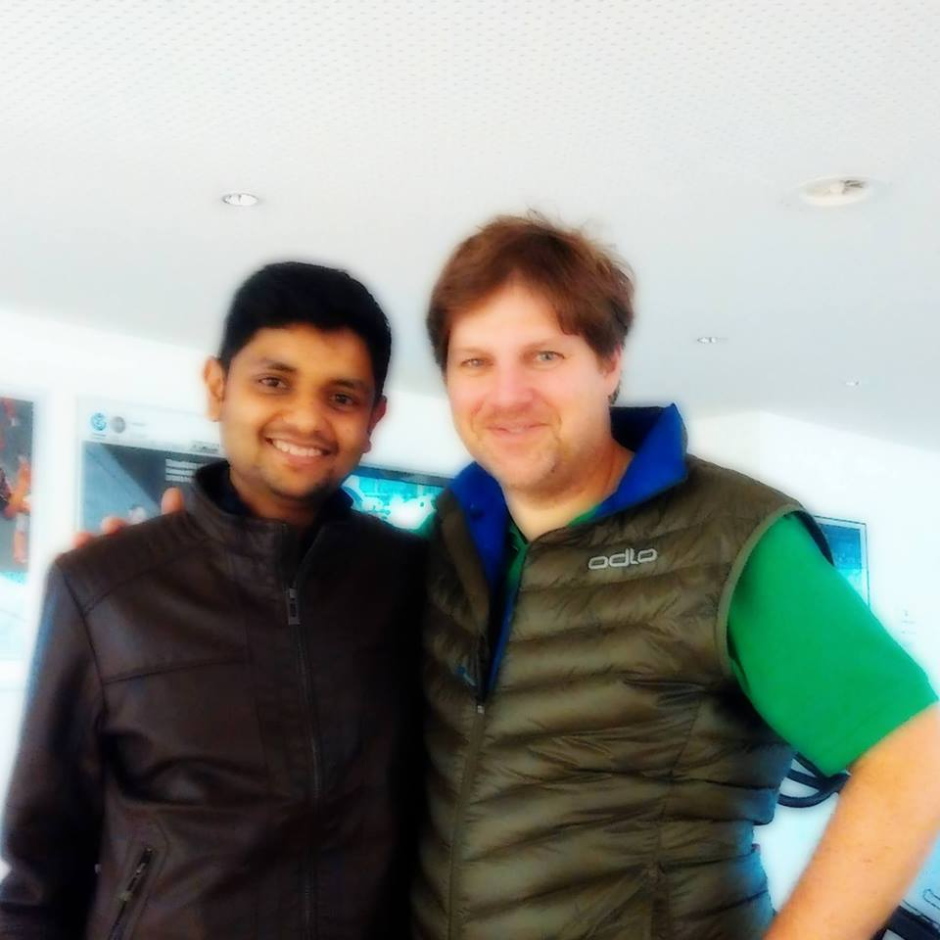
Prepare a check list !!!
Checklist routines avoid a lot of errors. You should have all this elementary [worldly] wisdom and then you should go through a mental checklist in order to use it. There is no other procedure in the world that will work as well." - Charlie Munger, 2007 speech at USC School of Law.
Take help from WB, Phil Fischer, Peter Lynch, Graham etc to prepare your OWN investment check list.
Read the amazing book “The Investment
Checklist: The Art of In-Depth Research”
– Michael Shearn
Valuation and Management integrity should be integral part of the check list. We should not buy even a great business at any available price. No matter what !!!

Slide 8
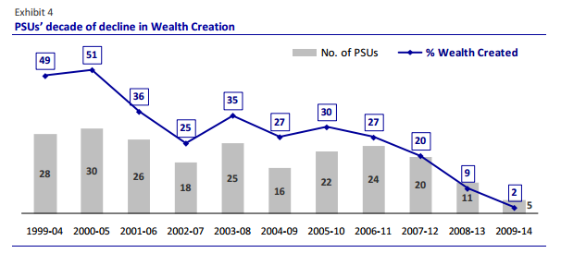
What I will Not Buy ?
Companies that are cyclical in nature and closely dependent on Monsoon and climatic changes.
PSU stocks and companies with high Government intervention like Sugar, Railway stocks etc.
BSE – Only listed Stocks.
Motilal Oswal 19th wealth creation study shows that:
The Wealth Created by these 5 PSUs is also at an all-time low of just 2% of total, from as high as 51% over 2000-05, signaling total value migration to the private sector.

Slide 9
When to sell ?
Did I make a mistake?
If you have made a mistake analyzing the company, and your original reason for buying is no longer valid, selling is likely to be your best option.
Has the company changed for the worse?
It would be great if solid companies never changed, but that’s rarely the case. If the fundamentals of a company change permanently—not temporarily—for the worse, you may want to sell.
Is there a better place for my money?
The best investors are always looking for the best places for their money. Selling a modestly undervalued stock to fund the purchase of a super cheap stock is a smart strategy.
Huge run up in the price and has the stock become too large a portion of my portfolio?
Selling a stock when it becomes a huge part of your portfolio can make sense, depending on your risk tolerance.
Did the management indulge in any mischievous acts against the interest of minority share holders ?

Slide 10


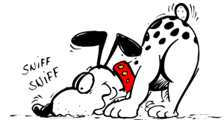
How to avoid FOMO effect ?
“If you chase fancy stocks, you have to pay fancy prices and when the fancy ends you have a fancy losses.” – Parag Parikh.
You can’t be like a sniffing dog in investing. There is no need to buy each and every good company that you come across.
The only loss by NOT owing another good
company is Opportunity loss & That’s BIG.
We are not in an Investment race with others.

Slide 11
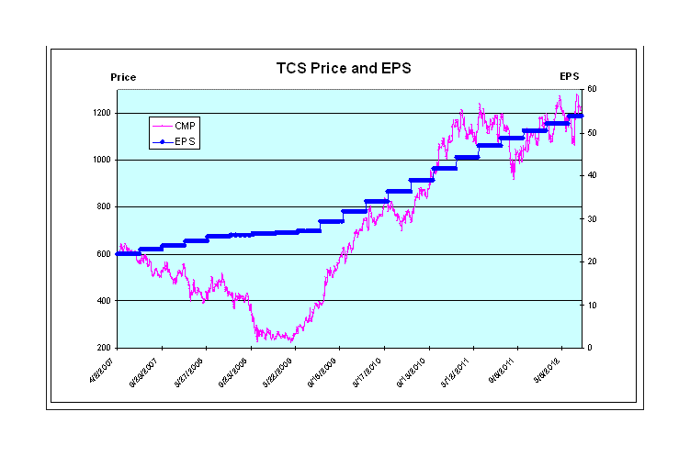

Why behavioral / psychology is part of Investing ?
For Example, here is the PE & EPS graph of TCS from past 8 years…
Calculating EPS will be taken care of Damodaran !!!
But how to calculate PE, i.e HUMAN MADNESS ???

Slide 12
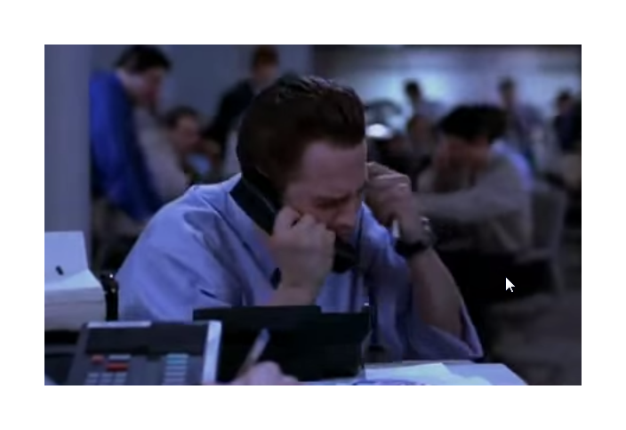
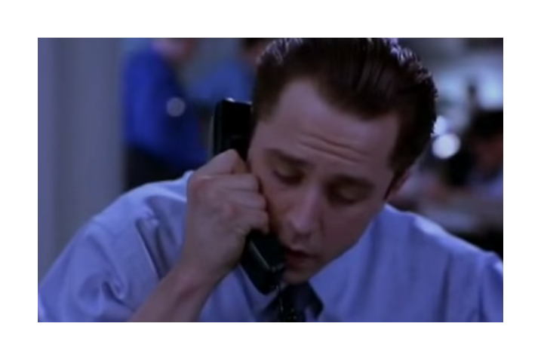
Lollapalooza effect
ONE IDEA AND ONE IDEA ONLY
SETH INVOKES THE SCARCITY MODEL HERE
you're a doctor. Have you ever heard of a drug called Fenamul ?
INFLUENCE FROM MERE-ASSOCIATION TENDENCY I.E. ASSOCIATION OF DRUG WITH DOCTOR

Slide 13


it's in the third stage of FDA approval right now. it's going to get approved in the next three months. Could be tomorrow for all I know.
AUTHORITY MISINFLUENCE TENDENCY - FDA AS AUTHORITY HERE. ALSO SCARCITY - SCARCE, VALUABLE INSIDE INFORMATION PRESENTED EXCLUSIVELY
Wait Wait Wait….
DEPRIVAL SUPERREACTION TENDENCY - DR JACOBS REACTS TO THE POTENTIAL LOSS OF AN OPPORTUNITY

Slide 14
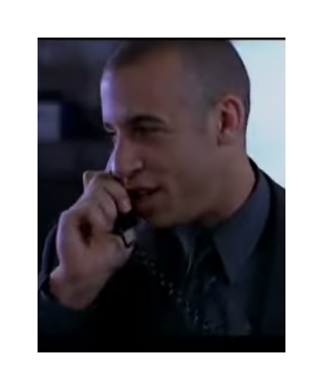
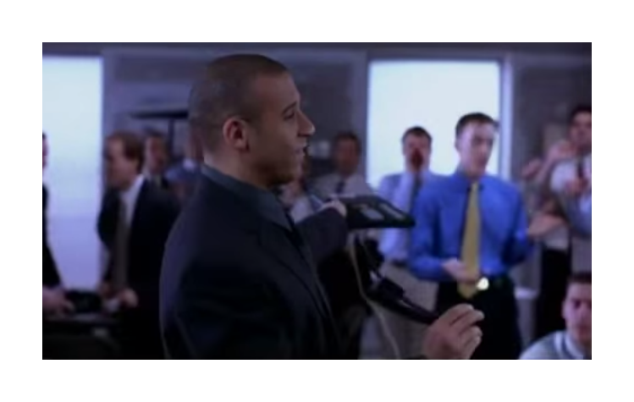
Senior broker who's more involved with this particular stock.
AUTHORITY MISINFLUENCE TENDENCY - SENIOR BROKER AS AN AUTHORITY FIGURE WHO IS SUPPOSED TO KNOW MORE
That's my trading floor, Doc. Now I have a million calls to make to other doctors who are already in the know
SOCIAL PROOF TENDENCY I.E. JUST HEAR HOW PEOPLE ARE NUTS OVER THIS STOCK

Slide 15
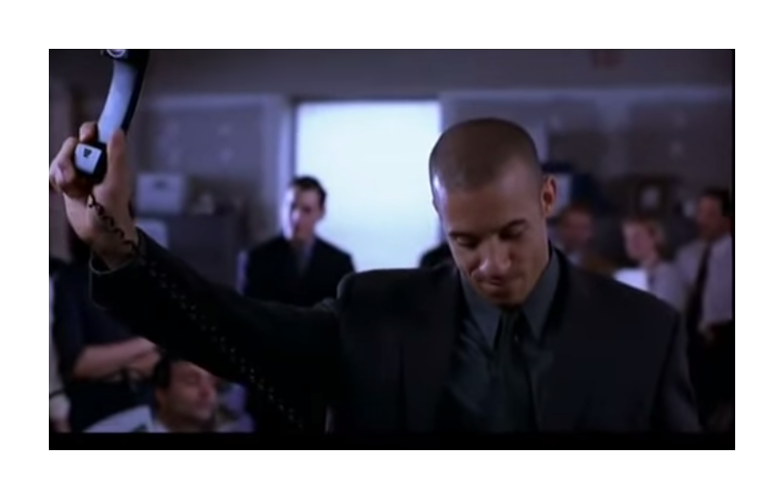

DEPRIVAL SUPERREACTION TENDENCY + SOCIAL PROOF TENDENCY + AUTHORITY + ENVY

Slide 16

Still not satisfied !!! Want MORE…
AVAILABILITY MISINFLUENCE TENDENCY - CHRIS VERY CLEVERLY NOW MENTIONS A FIGURE OF 2,000 SHARES WHICH IS
PROBABLY MORE THAN WHAT DR. JACOBS WOULD HAVE BOUGHT - HE CREATES AN AVAILABLE ANCHOR IN THE MIND OF DR. JACOBS

Slide 17
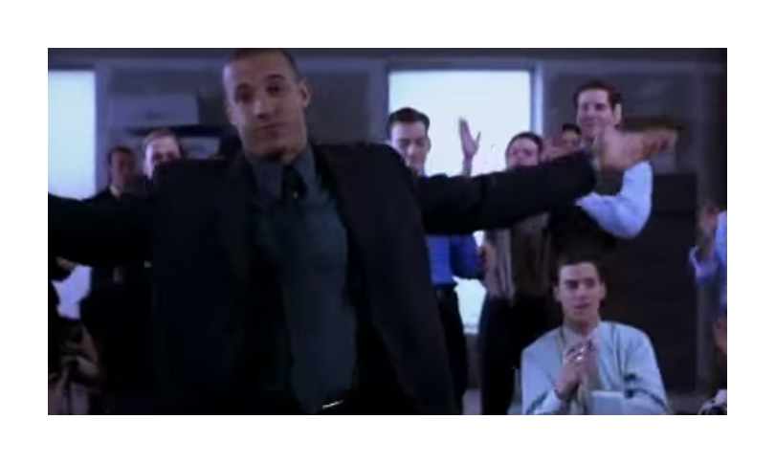
MISSION ACCOMPLISHED! - THEY GOT HIM

Slide 18
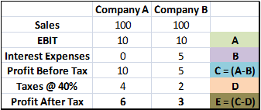
Is it OK to pay little more for Quality ?
Consider two companies, Company A (CMP: Rs 60/-)and Company B (CMP: Rs 10/-). They are actually into same sector and have same sales, the same operating earnings, the same everything except that Company A has no debt and Company B has a debt at a 10 percent interest rate. (All numbers are per share basis).
In first scenario, lets consider both the companies are growing.
Now the PE of Company A is (assuming EPS is 6): 60 / 6 = 10 PE
PE of company B is (assuming EPS of 3): 10 / 3 = 3.33 PE
Company A’s PAT is 100% greater than Company B.
So which is CHEAP among A & B ?

Slide 19

Now, lets consider the same companies in low growth scenario:
Assume the growth has been hampered and EBIT fell from 10 to 7 this year. Tax remains same.
Company B has to pay the same interest of Rs 5/- even in low growth times, where as company A can simply hand over its profits to share holders.
Now Company A’s PAT is 350% greater than Company B.
-Warren Buffett, 1989 Letters to Berkshire shareholders.

Slide 20






How many stocks do I own ?
I personally feel, it is much better to dig a mile deep into few companies than an inch deep in many.
The Pride of owing World class businesses
(Remember this pride only comes when you do NOT overpay)

Slide 21

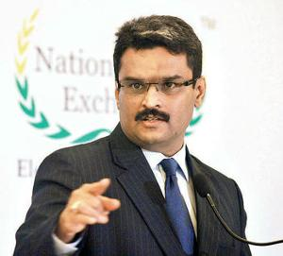
Finally…
“Everyone is fond of Brands. All of us wants to own some of them. But how do you want to own them, as an end customer or as a share holder?? Both are different approaches and they take you in different direction in your financial life.”
Always buy only the:
Businesses which would be able to understand and which are simple to explain to a laymen.
Run by a credible management. Understand that Management is more important even for an extraordinary business. Example: MCX
Businesses which have strong moats around it.
Pricing power.
Above all, available at reasonable valuations.

Slide 22


Slide 23


